Slide 1

CREDIT CARD FRAUD DETECTION
Submitted To:
Mr. Sanjay Madan
Submitted By:
Arpit shrivastav
Shubham

Slide 2
CONTENTS
INTRODUCTION
OBJECTIVES
DATASET
EDA
ALGORITHM USES
COMPARISON TABLE
BEST PERFORMING ALGORITHM
CONCLUSION

Slide 3
INTRODUCTION
The project aims to predict fraudulent credit card transactions using machine learning models.
Every fraud is a loss to the bank as the bank is responsible for the fraud transactions. This is crucial from the bank’s and the customer’s perspectives. The banks cannot afford to lose their customers’ money to fraudsters.

Slide 4
OBJECTIVES
Implementing Various machine Learning Model.
Checking which algorithm work best.
Credit card fraud detection aims to reduce payment fraud losses for both merchants, issue banks, and increase revenue opportunities for merchants.

Slide 5
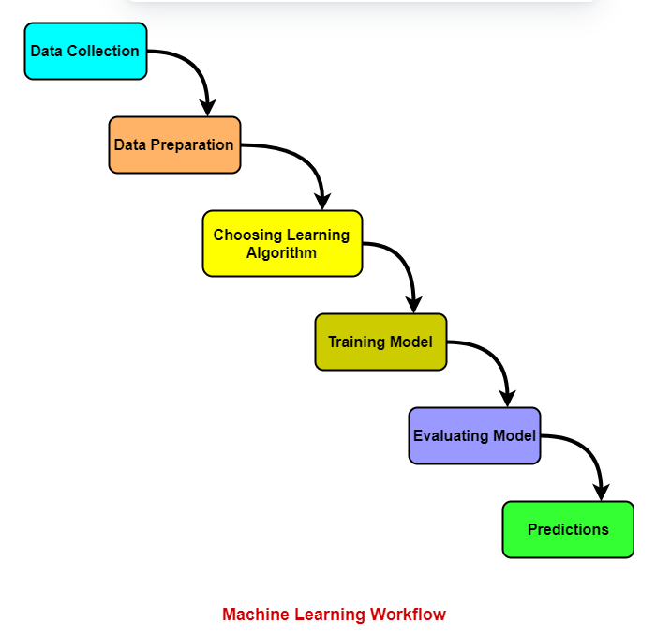
WORKFLOW

Slide 6
DATASET
The data set includes credit card transactions made by European cardholders over a period of two days in September 2013. Out of a total of 2,84,807 transactions, 492 were fraudulent.
Dataset Source: Kaggle
Dataset Link: https://www.kaggle.com/mlg-ulb/creditcardfraud
Size – 67.4 MB , Rows - 2,84,807, Columns - 31
No Null Values are present in the Dataset.
Features | Description
Time | The second elapsed between Each Transactions.
V1-V28 | The principal components obtained with PCA Transformations
Amount | The transaction Amount
Class | This is response variable and it takes value 1 in case of fraud and 0 otherwise.

Slide 7
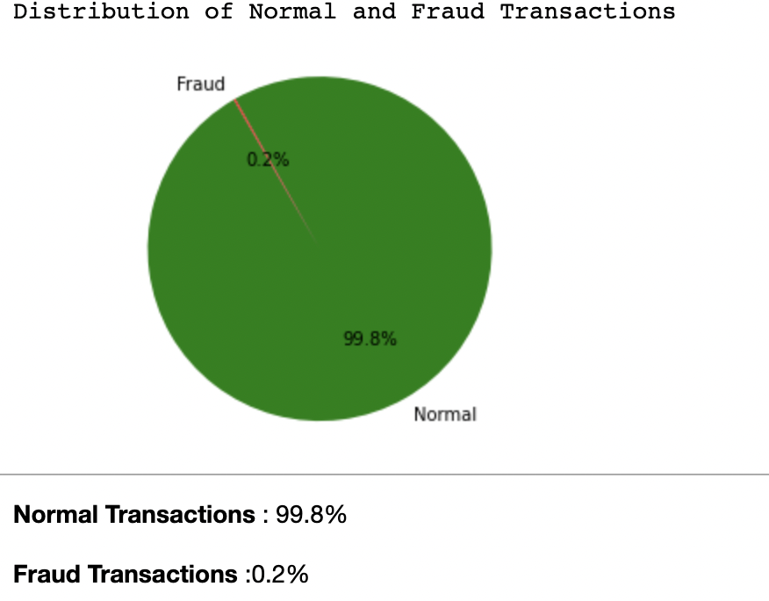
EDA(Exploratory Data Analysis)
Due to sensitivity of the data our Dataset is already PCA Transformed

Slide 8
EDA (Exploratory Data Analysis)
This shows the correlation matrix of the dataset.
This matrix explains that attribute class is independent of both the amount and time of the transaction was made.
It is even clear from the matrix, the class of the transaction is depending on PCA applied attributes.

Slide 9
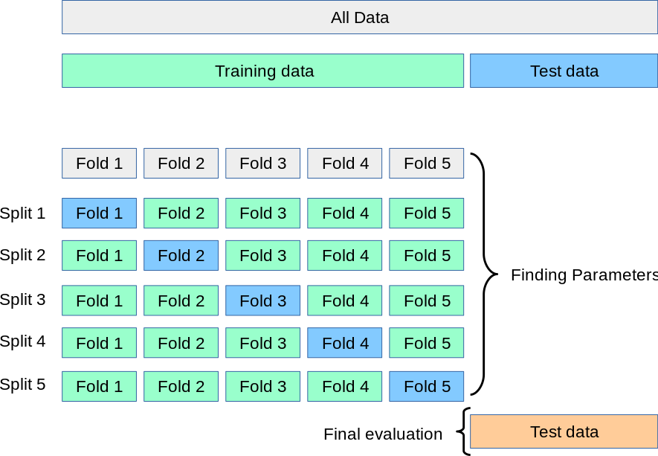
K Fold Cross Validation.
K-fold cross-validation approach divides the input dataset into K groups of samples of equal sizes. These samples are called folds.
For each learning set, the prediction function uses k-1 folds, and the rest of the folds are used for the test set. This approach is a very popular CV approach because it is easy to understand, and the output is less biased than other methods.

Slide 10
ALGORITHMS USED
ML Algorithms
Supervised Algorithm
UnSupervised Algorithm
Support Vector Machine
Logistic Regression
Random Forest Algorithm
Decision Tree
K-Nearest Neighbour

Slide 11
COMPARISON TABLE
MODEL | ACCURACY | ROC_VALUE | TRESHOLD
Logistic Regression | 0.99034 | 0.980231 | 0.001999
KNN | 0.999192 | 0.805746 | 0.2
Decision Tree | 0.998841 | 0.826249 | 1.0
Random Forest | 0.999438 | 0.946472 | 0.01
SVM | 0.99828 | 0.40177 | 0.002123

Slide 12
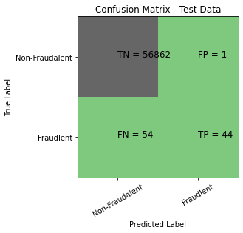
Best Performing Algorithm
LOGISTIC ALGORITHM :

Slide 13
Conclusion
So this project is used for predicting the fraud related to the credit cards.
In this project we have used various machine learning algorithms such as KNN, Random forest, Decision Tree and Logistic Regression.
But the best one algorithm whose accuracy is highest is:- Logistic Regression
Logistic Regression performed the best among all the used models .
Logistic Regression had the highest accuracy of 0.99034 and roc_value of 0.980231.

Slide 14
THANK YOU
🙏🏻😊🙏🏻

